Slide 1

Jeans Manufacturing Project using Python
Made by Rahul Rajak

Slide 2
Agenda
a) Business Specification/Requirements:
A business Specification details the business solution for a project including the order of customer needs and expectations.
1. The Cost of the product should be Effective.
2. The Failure of Payment Should be less.
b) Functional Output/Requirements:
1. The Application should allow to Registering or Login.
2. The Application Should ask Basic details for registering to the app like Full name, Email id and Password.
3. The Application should ask Basic Jeans items details for order and after that Payment.

Slide 3
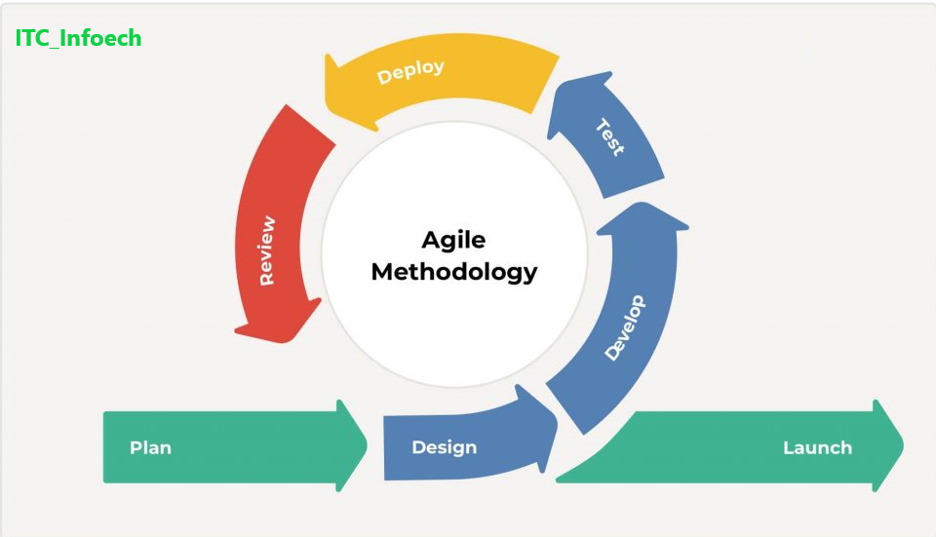
Agile Methodology

Slide 4
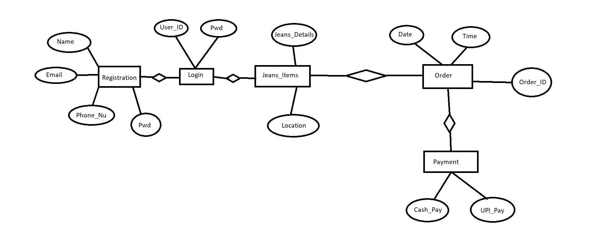
ER - Diagram

Slide 5



Tool Chain/Technical Coverage
PYCHARM IDE for Python, GitHub and AWS for Deployments
PyCharm IDE
GitHub
AWS

Slide 6
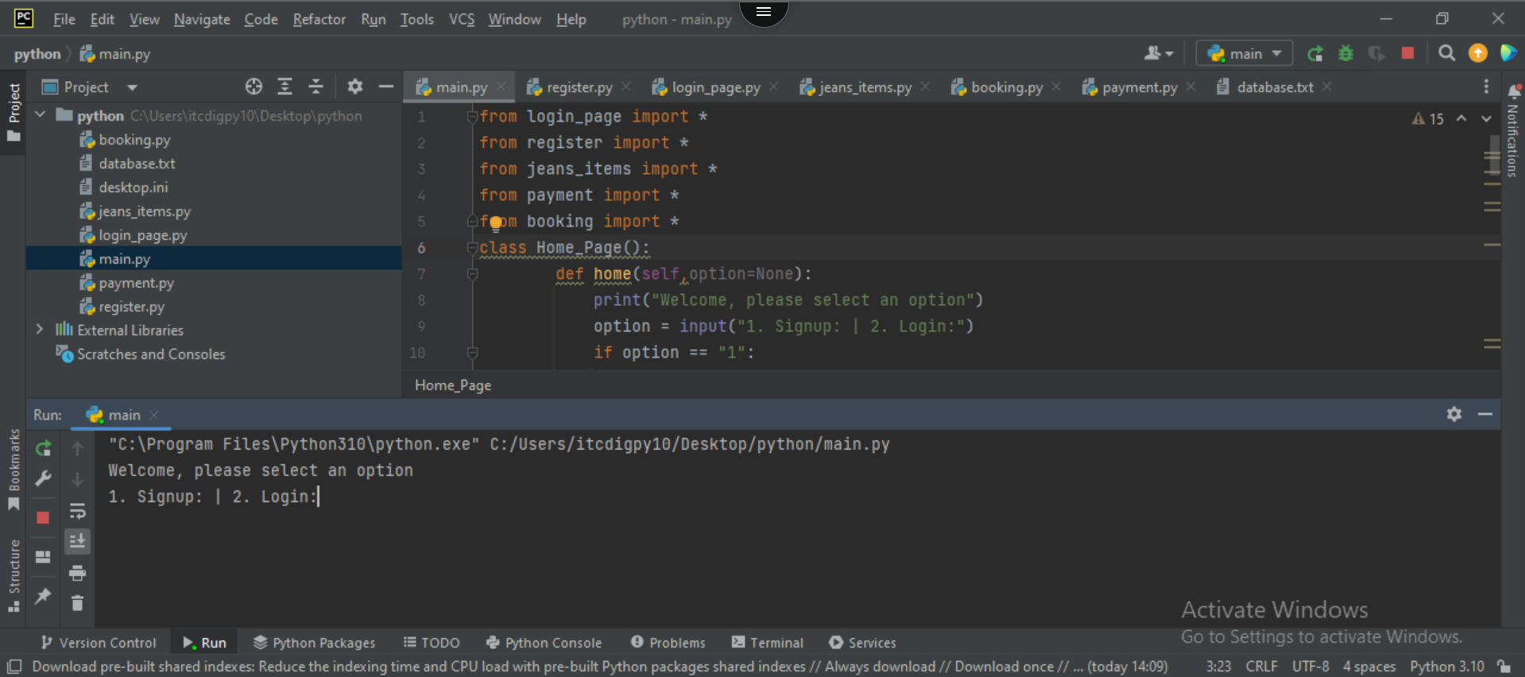
Pycharm IDE

Slide 7
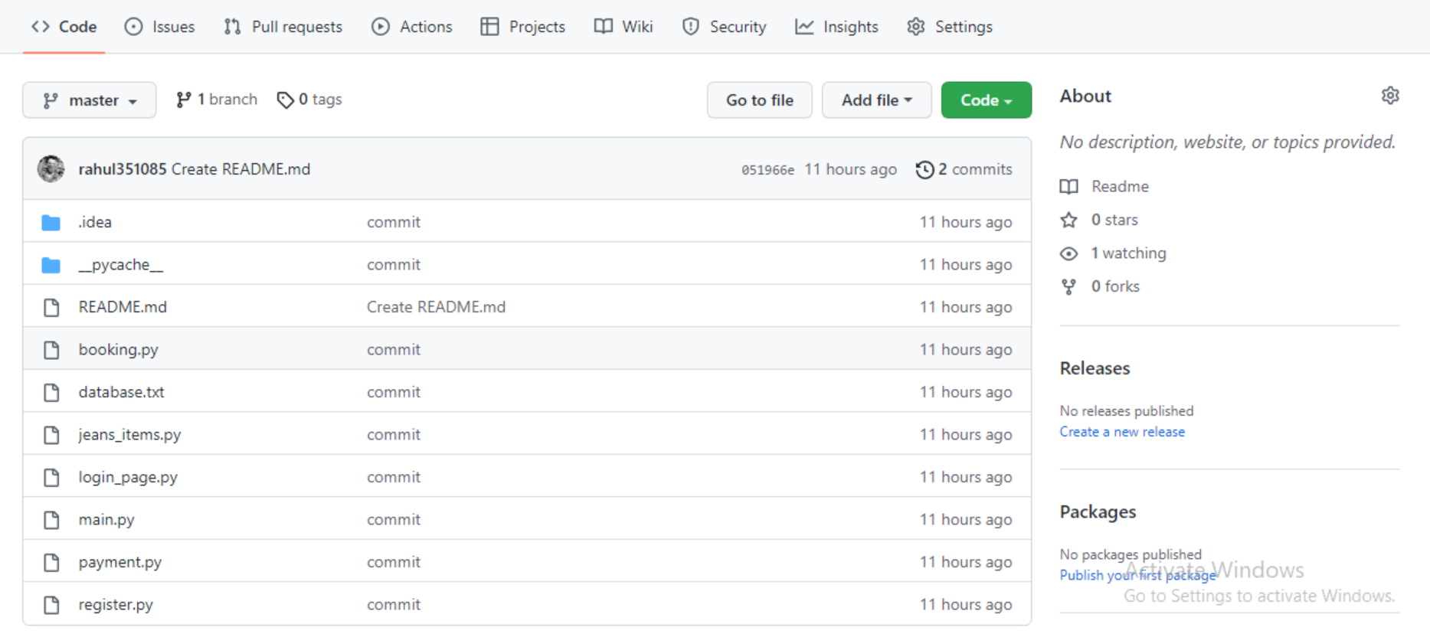
Pushing Project in Github

Slide 8
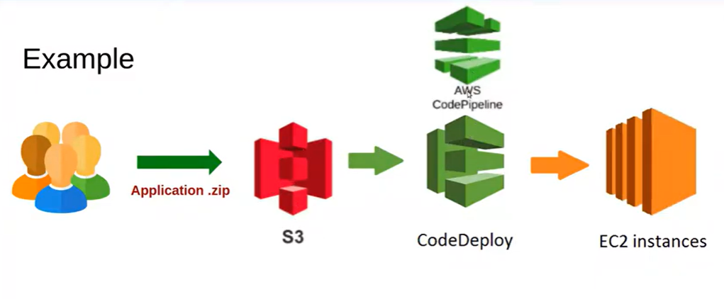
Deploy Python Project

Slide 9
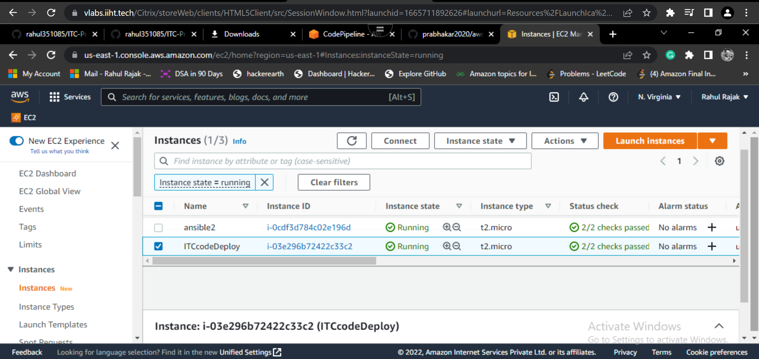
AWS Deployment

Slide 10

THANK YOU !

